Slide 1
Numerical problem on decision tree using entropy and gain

Slide 2
ID3 Algorithm
1. Invented by J. Ross Quinlan
2. Employs a top-down greedy search through the space of possible decision trees.
3. Greedy because there is no backtracking. It picks the highest values first.
4. Select the attribute that is most useful for classifying examples (the attribute that has the highest Information Gain).

Slide 3
Steps
1. Find the entropy
*Entropy for the entire dataset
*Entropy for each attribute
2. Find information gain
The Formula for Entropy:
Entropy(S)= -P(yes)log2P(yes)-P(no)log2P(no)
The formula for information gain:

Slide 4
P(YES)=P(YES)/P(YES)+P(NO)
P(NO)=P(N0)/P(NO)+P(YES)

Slide 5
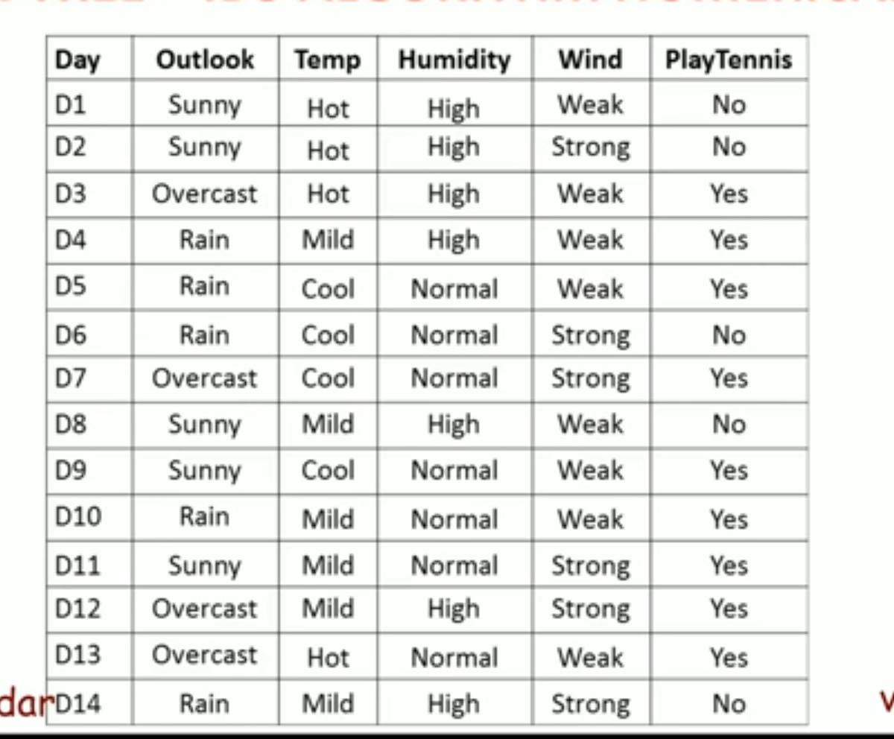

Slide 6
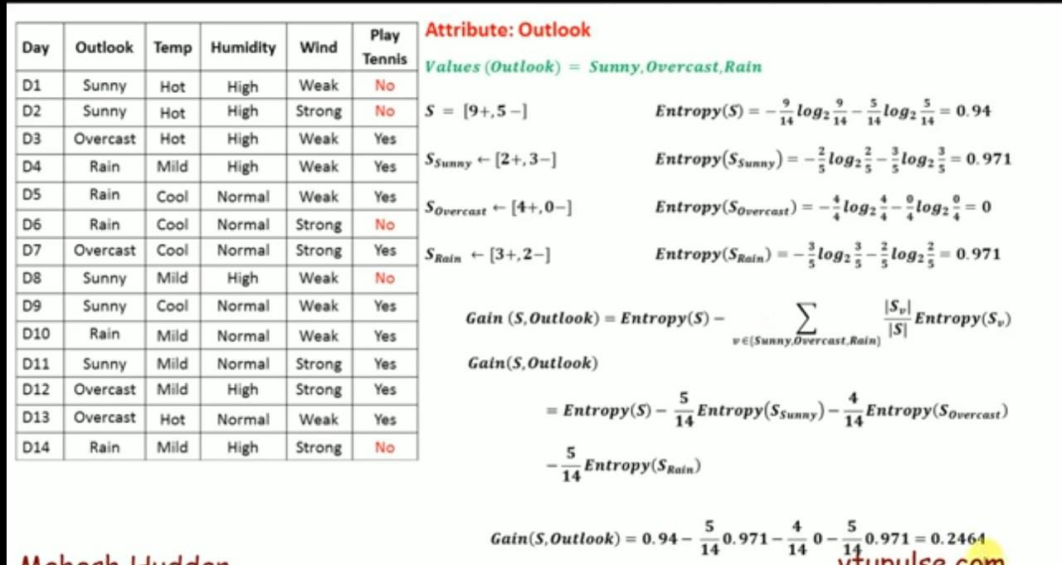

Slide 7
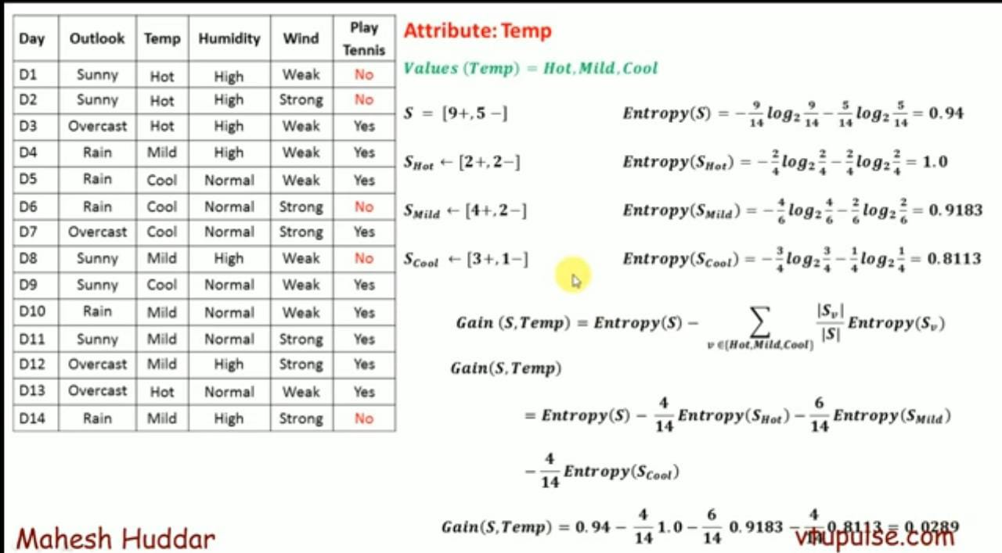

Slide 8
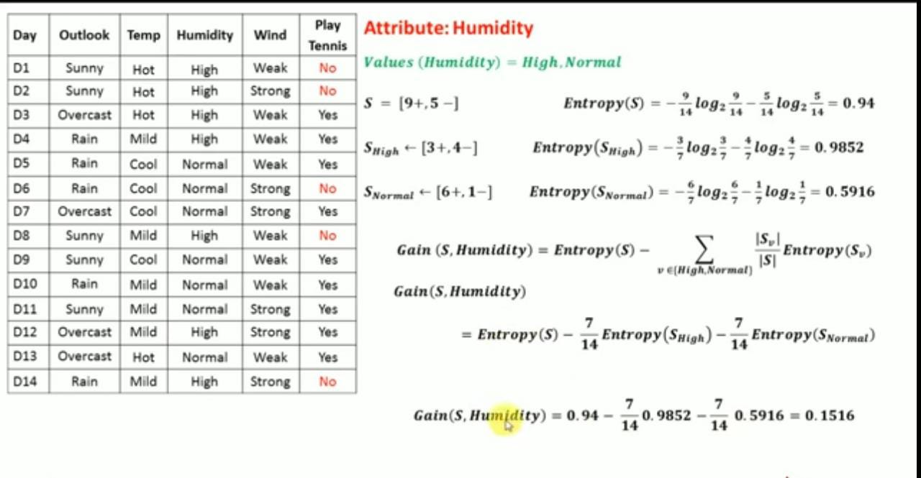

Slide 9
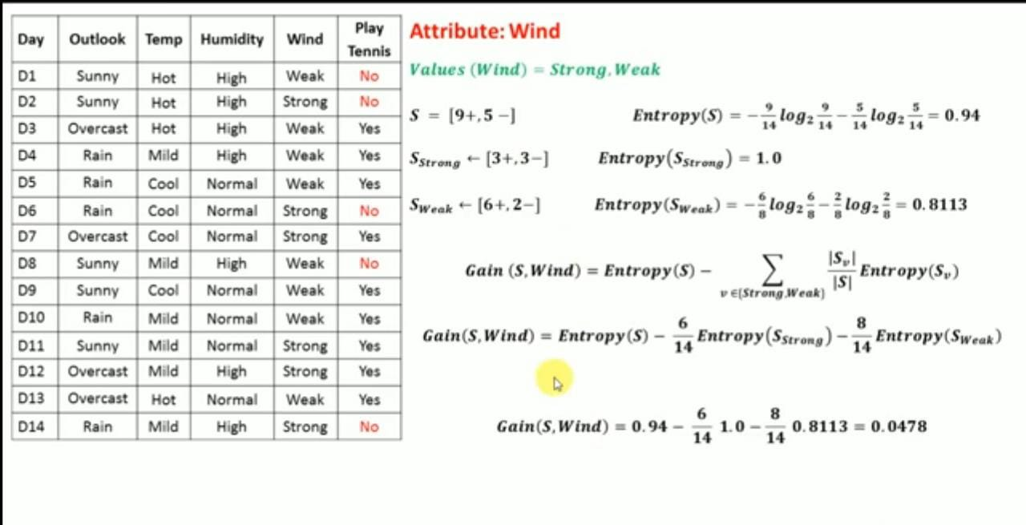

Slide 10
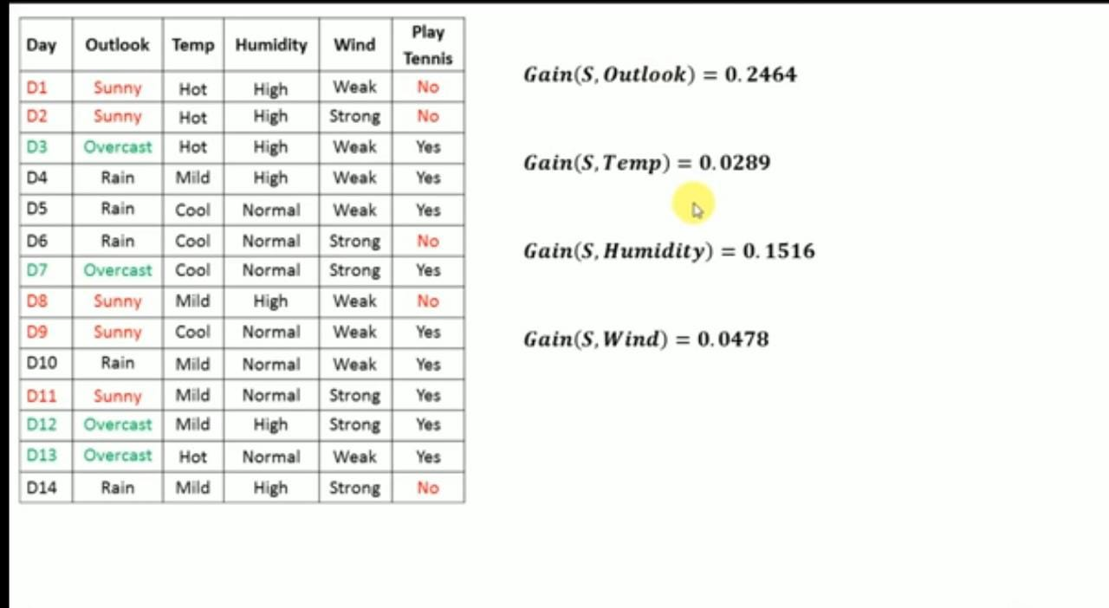
NOTE: As we can see gain is maximum for Outlook attribute so this will be consider as a root node

Slide 11
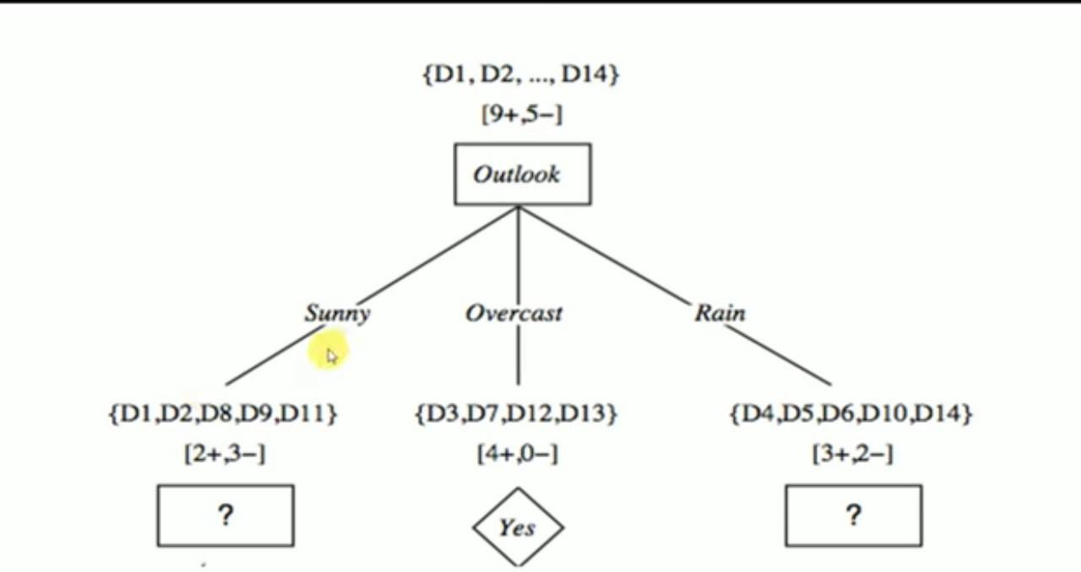

Slide 12
Numerical problem on decision tree using GINI INDEX

Slide 13


Steps
Find the Gini index for the entire dataset
Find the Gini index for each attribute
Formula for Gini index:

Slide 14
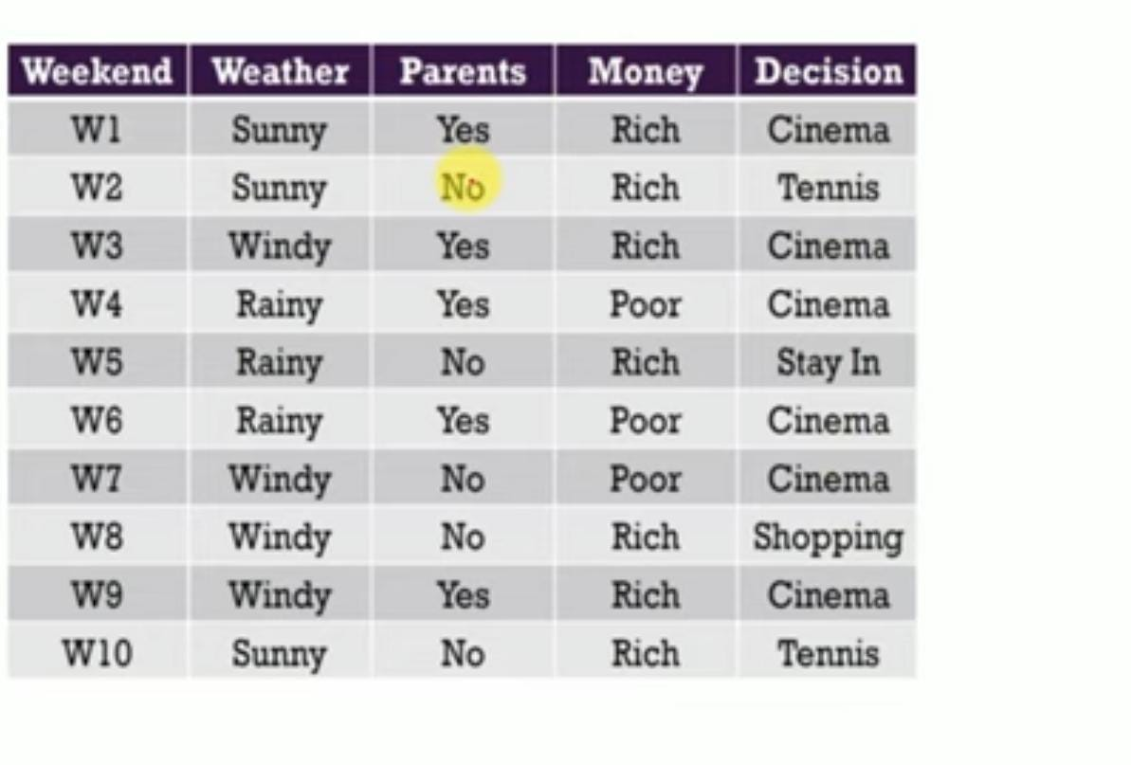

Slide 15
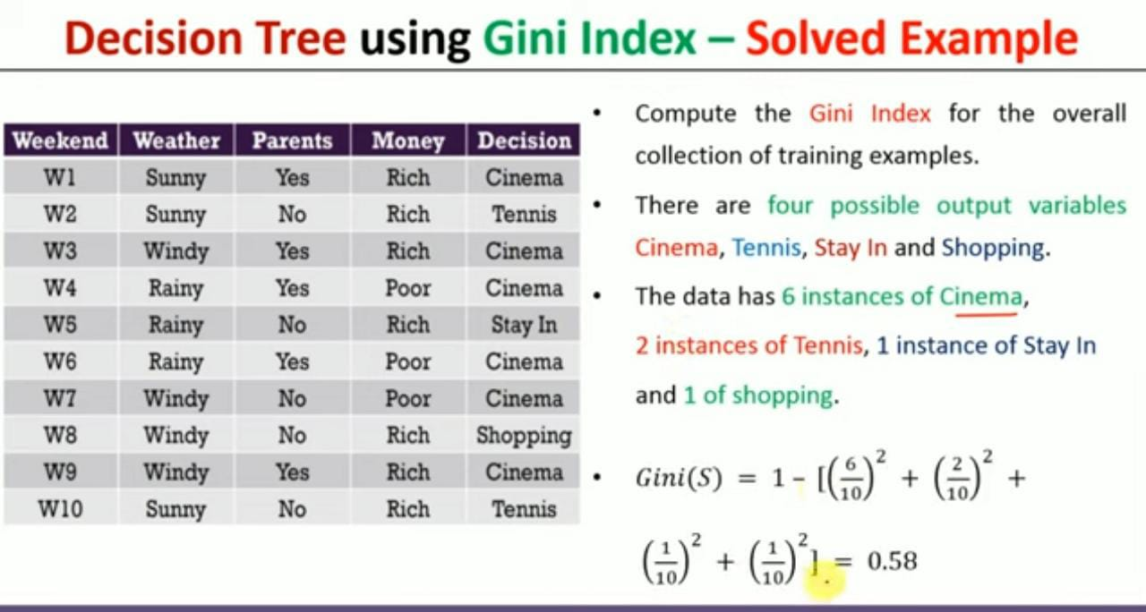

Slide 16
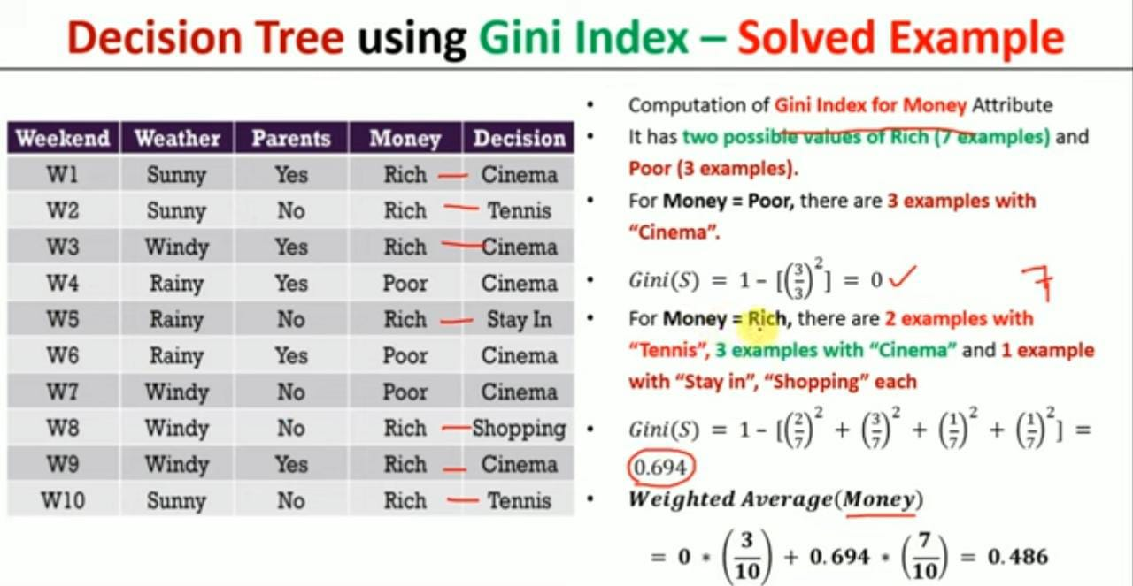

Slide 17
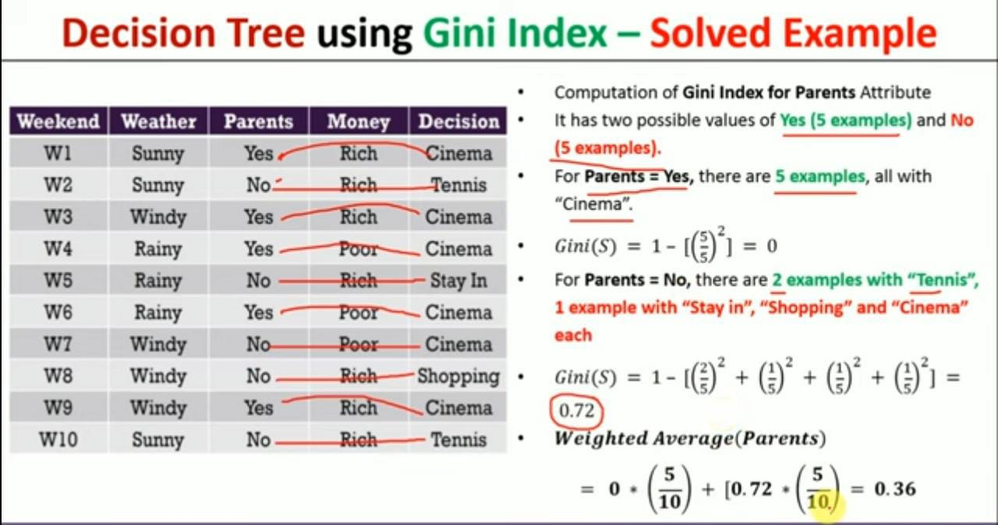

Slide 18
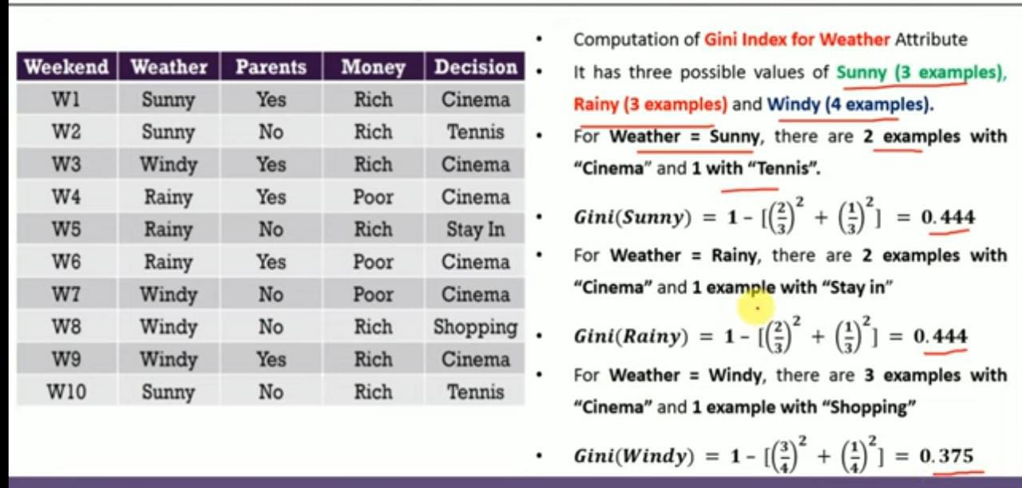

Slide 19
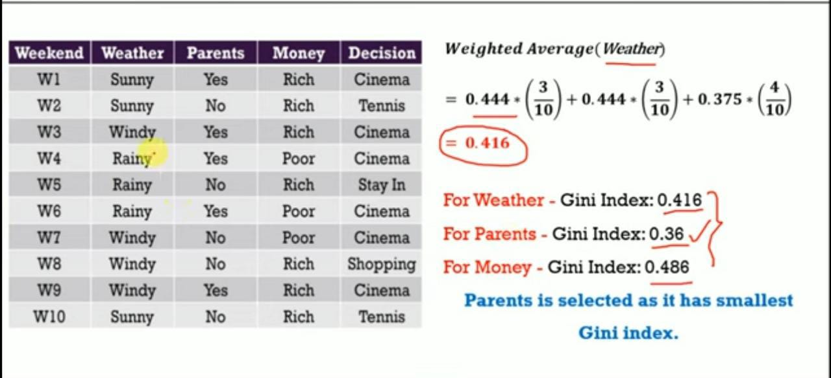

Slide 20
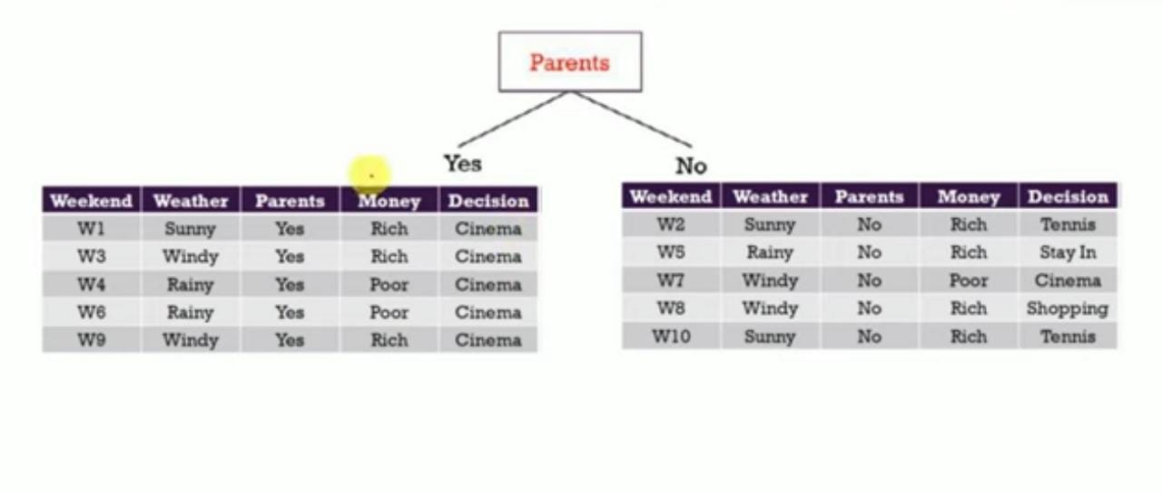

Slide 21
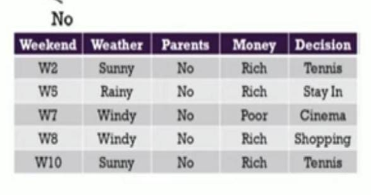
Parents
Yes
No
Cinema

